Slide 1
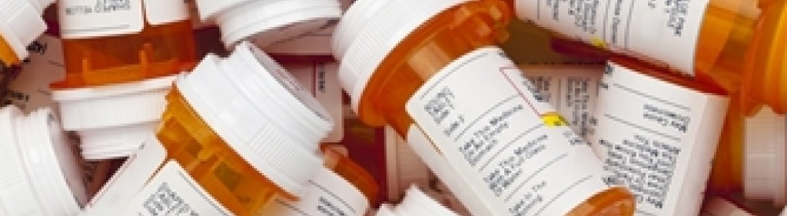
Combating Drug Crisis
The Battle of One
Notes:
How much hope does one have if they are fight their battle alone? Nothing in the fight against drug use disorder makes sense except in the light of societal supports.

Slide 2
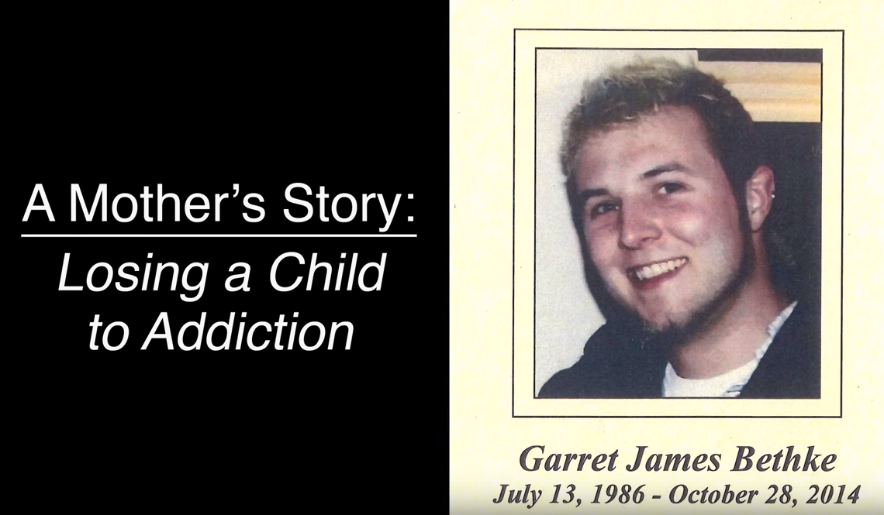
Notes:
This battle started with Gary but ended with his mother mourning for her loss. Gary was just 28 when he died of drug overdose.

Slide 3
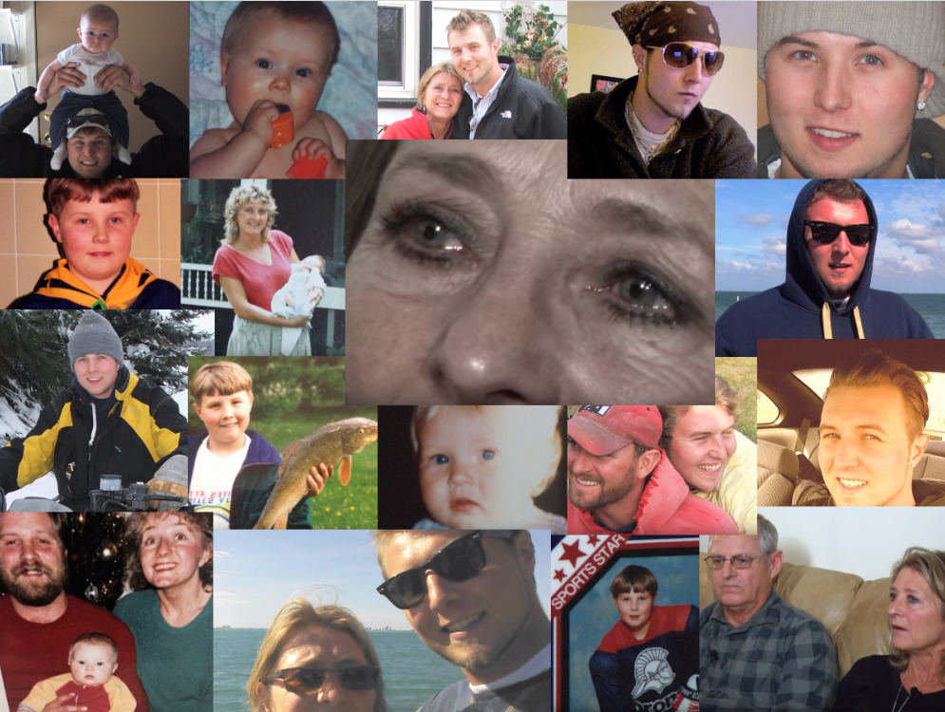
?
?
?
?
?
Notes:
Here is the problem:
Some say that it is only certain people’s problems. Certain stereotypes.
But Gary’s mother recalled: her son loved outdoor, played music, loved going to concerts, loved helping others, and did well in school. He was a phenomenal artist. He played baseball, hockey, soccer and football. He was a boy scout. He did all those typical things. He was a typical kid from the suburbs.
Garry’s mother is puzzled with lots of questions: “Did I ever in my wildest nightmare think that my bright, three-year-old kid that was the happiest … he was good in school … Did I ever think that my son’s going to grow up to be a heroin addict. Did he ever think that?” You probably say, “Nah, that won’t happen to me or my family.” Gary’s mother had to admit that you can’t ever say that it can’t be my child … Because it can be. No one wants to live that wrenching every day, wondering, “Is this going to be the day that I get the phone call?”
In fact, studies show that drugs do not discriminate against anyone and consume all sorts of victims. People of any age, races, gender, social classes may fall victims. You know somebody directly or indirectly who has drug problems or who knows someone who is struggling to get cleaned.
Reference: https://www.youtube.com/watch?v=J463w4pck74

Slide 4
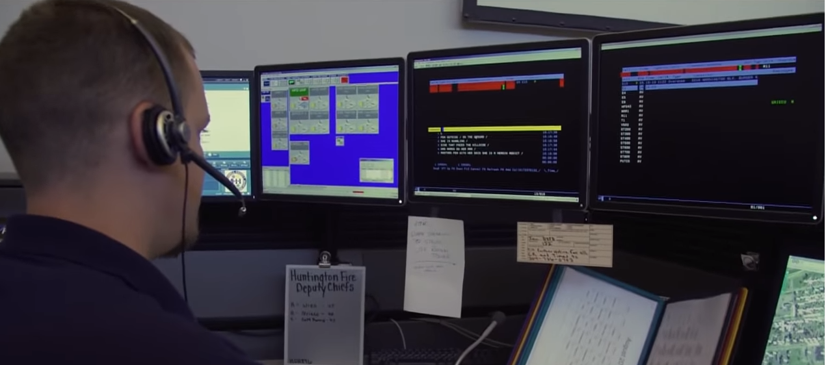
A Local Emergency Call Center
Notes:
This local call center deals with one emergency at a time … and they send out medical teams with urgency to save lives. But too frequently, theses calls did not have a happy ending.
Reference: https://www.youtube.com/watch?v=w67IDMY2tn8&t=357s (At the epicenter of America's opioid epidemic, Huntington, West Virginia’s growing addiction problem has overwhelmed everyone from first responders to business owners to newborns. So far, the city's robust efforts to fight back haven't been enough to curb the overdoses.)

Slide 5
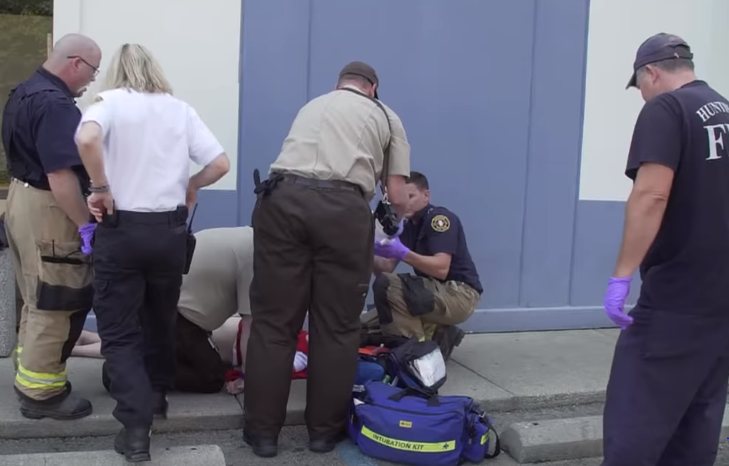
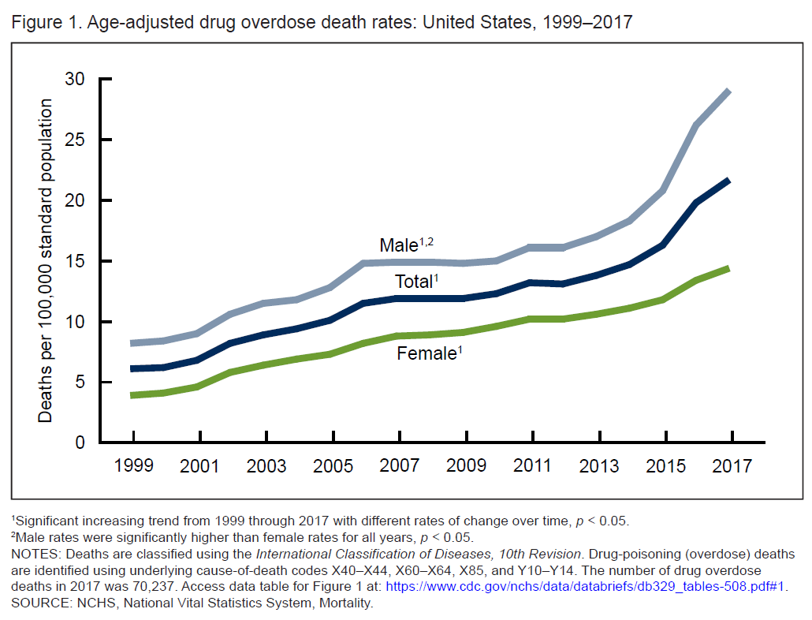
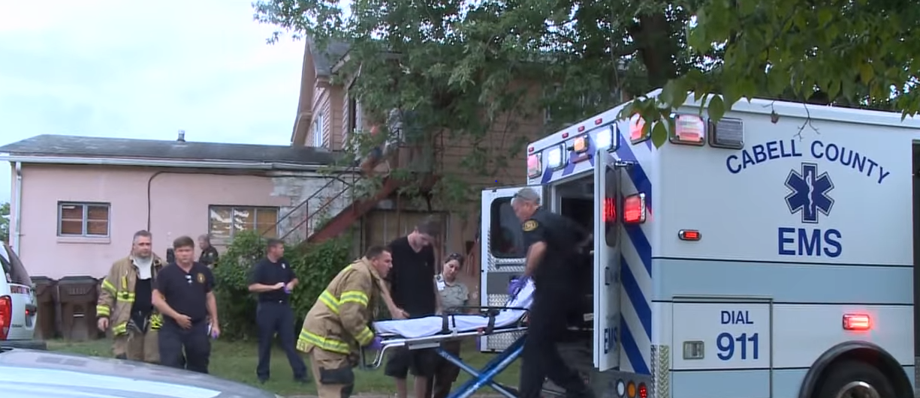
Drug Overdose Death Rates, by Gender
Notes:
Response teams rushed to homes and to the streets and lives are saved when Naloxone is administered at the time of overdose as an antidote to opioids. But people whose lives are saved have trouble breaking free from the dependence. Therefore, call centers keep sending medical services to the same people confront but failed to address the root of the problem while death rates keep rising from 1999 through 2017. There is a significant increasing trend from 1999 through 2017 with different rates of change over time, p < 0.05. Male death rates are consistently significantly higher than female rates for all years, p < 0.05.
References:
https://www.cdc.gov/nchs/products/databriefs/db329.htm (CDC data brief: “Drug Overdose Deaths in the United States, 1999–2017”, NCHS Data Brief No. 329, November 2018)
https://www.youtube.com/watch?v=w67IDMY2tn8&t=357s (At the epicenter of America's opioid epidemic, Huntington, West Virginia’s growing addiction problem has overwhelmed everyone from first responders to business owners to newborns. So far, the city's robust efforts to fight back haven't been enough to curb the overdoses.)
https://ldi.upenn.edu/brief/expanding-access-naloxone-review-distribution-strategies (“Expanding Access to Naloxone: A Review of Distribution Strategies”)

Slide 6
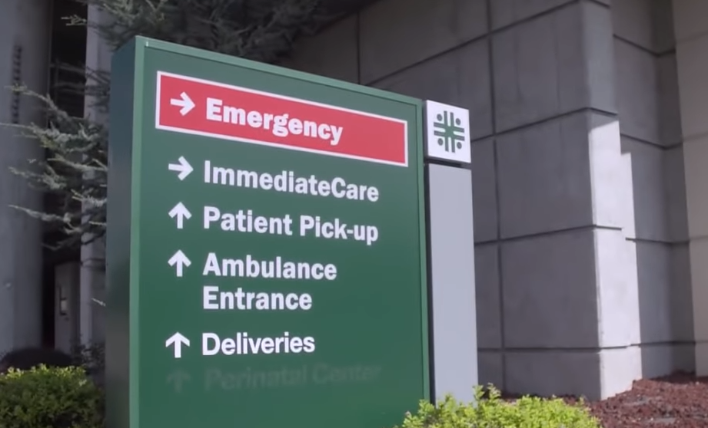
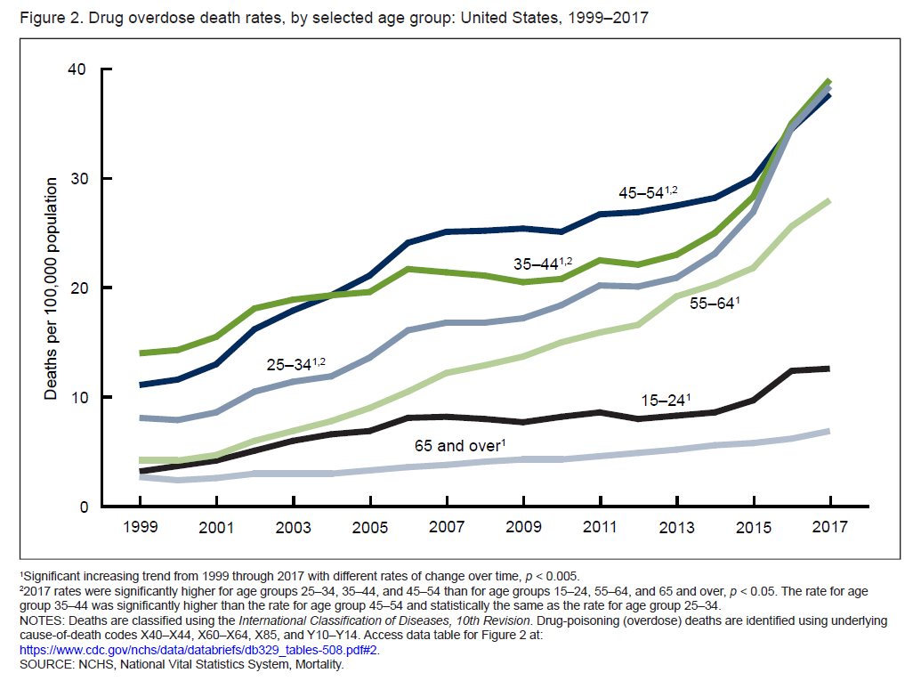
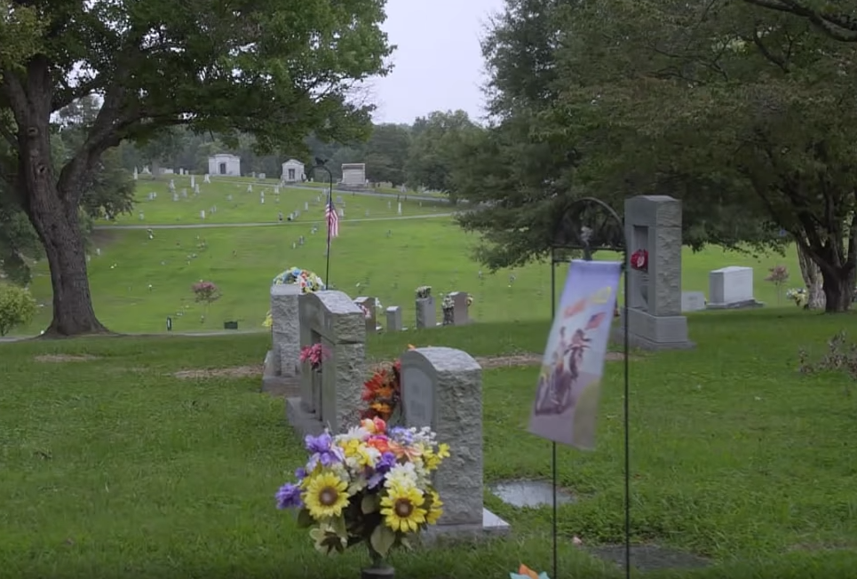
Drug Overdose Death Rates, by Selected Age Group
Notes:
Some people made it to the emergency rooms, but the death rates continue to rise from 1999 through 2017. 2017 rates were significantly higher for age groups 25-34, 35-44 and 45-54 than for age groups 15-24, 55-64 and 65 and over, with p < 0.05. Therefore, more and more people tell sad stories of losing their loved ones to drug overdose.
References:
https://www.cdc.gov/nchs/products/databriefs/db329.htm (CDC data brief: “Drug Overdose Deaths in the United States, 1999–2017”, NCHS Data Brief No. 329, November 2018)
https://www.youtube.com/watch?v=w67IDMY2tn8&t=357s (At the epicenter of America's opioid epidemic, Huntington, West Virginia’s growing addiction problem has overwhelmed everyone from first responders to business owners to newborns. So far, the city's robust efforts to fight back haven't been enough to curb the overdoses.)

Slide 7
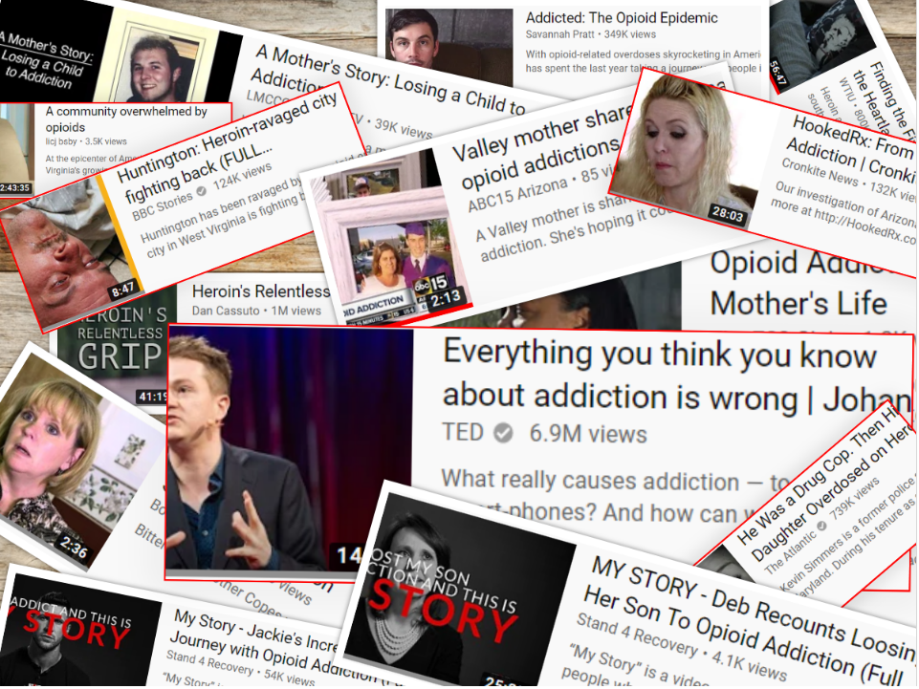
Notes:
These people’s stories are not just a data point that makes up part of the graphs in the last two slides. They all went through immense struggles trying to get cleaned but failed. But they are not the only who were hurt. Their friends and families and, even, their community, the society and the nation suffer.
Therefore the question is: What can be done to combat the drug crisis?

Slide 8
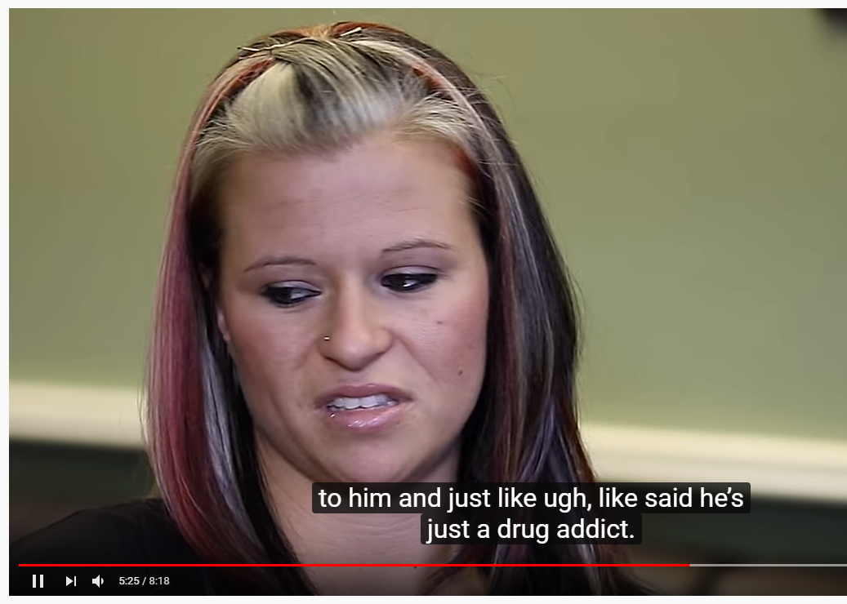
Randi’s Story: Seek Help & Overcome Social Stigma
Notes:
Here is one success story:
Randi was blessed to have recovered. She told her story, trying to help others fight their battles. Her doctor prescribed her pain pills for temporary relief to her physical pain, but the pills quickly took over her life and caused her emotional and mental pain. She became physically dependent on the pills and started to steal, lie and do anything to get them, just to avoid withdrawal symptoms to survive. But surviving did not make her problem go away. She recalled that she lost self values, her morals, her job, friends, families, her house, and a chance to become a nurse. And she became homeless, carless and even shoeless at one point. Eventually, she ended up in jail. But to her jail time gave her relief that she did not need to degrade herself or cover up her problems anymore. Therefore, she was forced to seek help and turned her life around.
Randi got into a treatment program, recovered and stayed cleaned. She re-claimed that she is a sister, an aunt, a girlfriend, a daughter, a step-mother, a recovery mentor, peer support specialist and a sponsor. She wants to help those who are struggling with drug addiction.
But she was devastated that her brother lost his battle. Her message of hope to others: admit that you have a problem and ask for help. Help is out there. You are not alone, Others can walk with you. Message to others: do not judge.
Drug Crisis is not a one person’s battle. It is a battle to be won by many together.
Reference: https://www.youtube.com/watch?v=Plvg8zuOvHE (“Addicted to Pain Pills: Randi’s Story”)

Slide 9
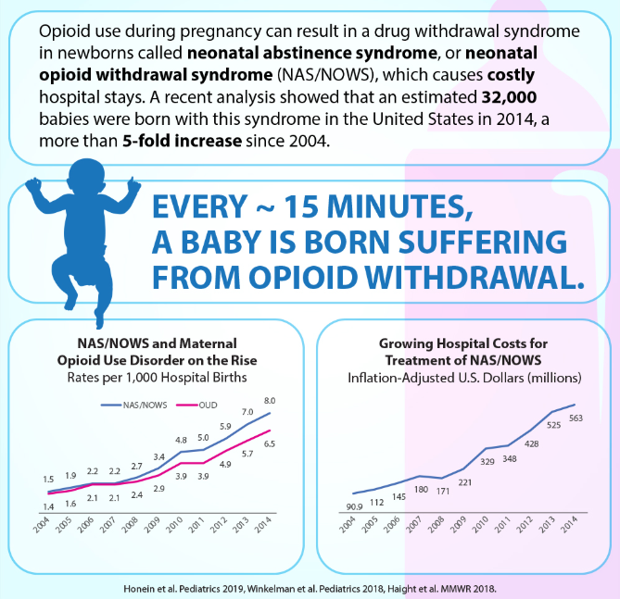
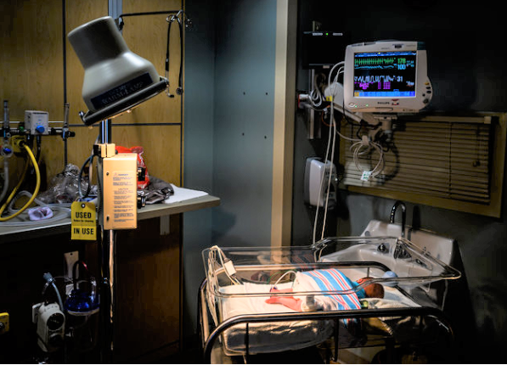
Innocent victims: 32,000 Babies in 2014
Notes:
Drug problems affect not only affect the lives of the individuals who are addicted, but also people around them, even innocent babies. Opioid use during pregnancy can result in drug withdrawal syndrome in newborns, called neonatal abstinence syndrome, or neonatal opioid withdrawal syndrome (NAS or NOWS). The graphs show rising birth rates and hospital costs for treatment of NAS/NOWS. 32,000 babies were born in 2014 with NAS/NOWS.
Many of the babies end up in the foster care system and need societal support for medical and special educational assistance. Drug problem ravages communities and the society. It drains hospitals, schools, businesses, jail system, welfare, Medicaid and even foster care system. It is a huge problem.
Therefore, the drug abuse epidemic is the battle of one nation.
References:
https://www.npr.org/sections/health-shots/2019/11/22/780796606/in-the-fight-for-money-for-the-opioid-crisis-will-the-youngest-victims-be-left-o (“In The Fight For Money For The Opioid Crisis, Will The Youngest Victims Be Left Out?” November 22, 2019)
https://www.drugabuse.gov/related-topics/trends-statistics/infographics/dramatic-increases-in-maternal-opioid-use-neonatal-abstinence-syndrome (“Dramatic Increases in Maternal Opioid Use and Neonatal Abstinence Syndrome”)
https://www.youtube.com/watch?v=w67IDMY2tn8&t=357s (“A Community Overwhelmed by Opioids: Huntingtin, West Virginia”)

Slide 10

Battle of One Nation
Notes:
The drug crisis must be fought together by the whole nation, uniting U.S. Federal government, state governments, local governments, private sectors, local communities, faith-based organizations, friends and families together.

Slide 11
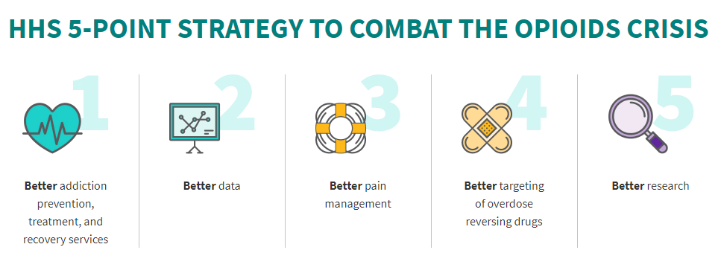
U.S. Department of Health and Human Services
https://www.hhs.gov/opioids/
Notes:
Fighting back from the U.S. government: U.S. Department of Health and Human Services leads the fight with 5-point strategy.

Slide 12
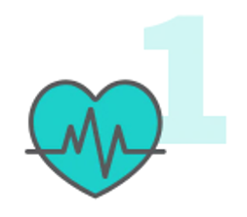
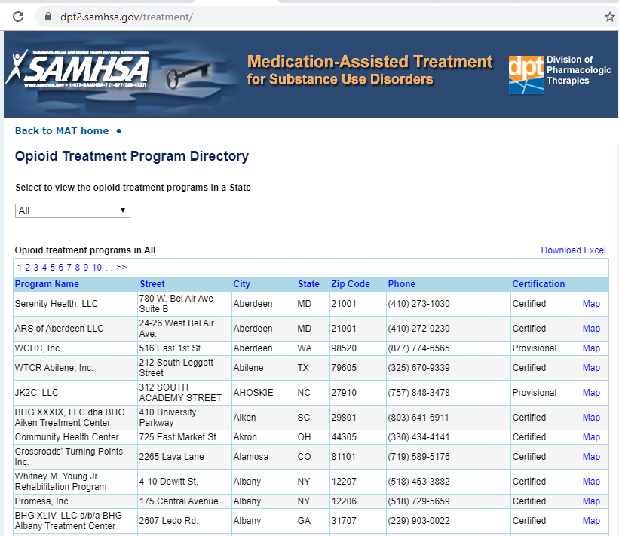
Better Prevention, Treatment and Recovery Services
$800 million
in grants
Notes:
Better prevention help those who are at risk, while better treatment and recovery services help those who are in need.
Substance Abuse and Mental Health Services Administration (SAMHSA) hosts an opioid treatment program directory that is searchable by state. Nothing in prevention, treatment and recovery services makes sense except in the light of accessibility to patients. In 2017, Health and Human Services provided over $800 million in grants to support access to opioid-related treatment, prevention, and recovery.

Slide 13

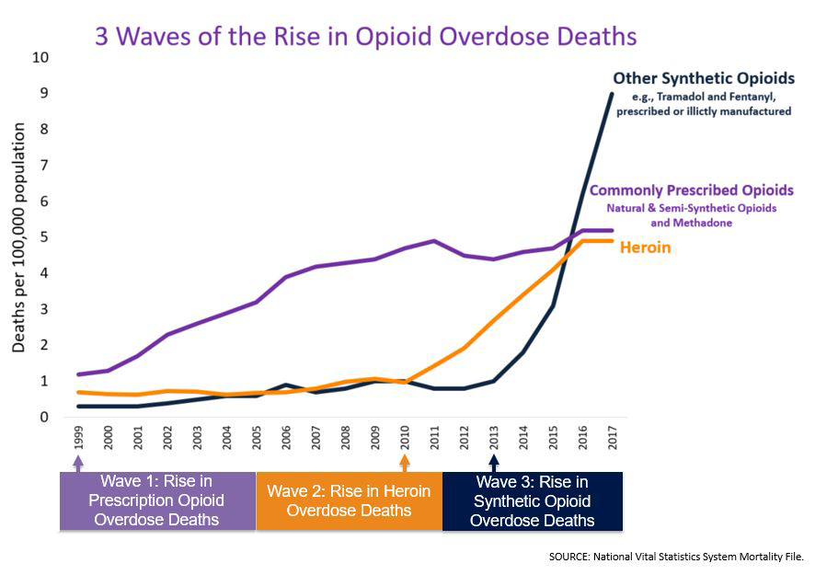
Drug Overdose Death Rates, by Opioid Category
Notes:
Better data helps understand the drug crisis and identify effective strategies for prevention and response efforts.
This graph shows drug overdose death rates by opioid category. There is a significantly increasing trend from 1999 through 2017 with different rates of change over time, p < 0.05. There were three waves of rise in opioid overdose deaths.
Wave 1: rise in prescription opioid overdose deaths in 1999. Wave 2: rise in heroin overdose deaths in 2010. Wave 3: rise in synthetic opioid overdose deaths.

Slide 14
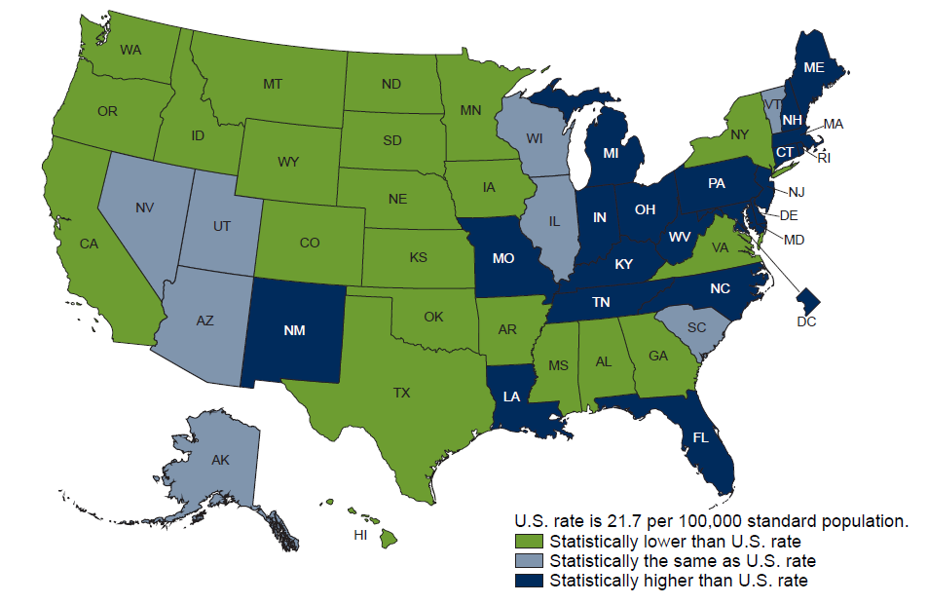
Drug Overdose Death Rates, by State
Notes:
Better data helps understand where the problem concentrates and the extend of the problem. Dark blue states have statistically higher drug overdose death rates than U.S. rate. Light blue states have overdose death rates that are statically the same as U.S. rate. Green states have statistically lower drug overdose death rates than U.S. rate.

Slide 15
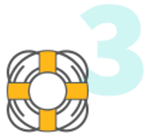
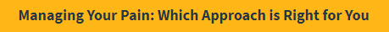
Pain Management Options
https://www.hhs.gov/opioids/prevention/pain-management-options/
TENS (transcutaneous electrical nerve stimulation) therapy
Meditation
Relaxation techniques
Visual imagery, e.g. picturing a peaceful scene
Biofeedback, which teaches control over muscle tension, temperature, heart rate and more
Heat and cold therapy
Notes:
Better pain management starts with knowing your options. The U.S. Department of Health and Human Services provide links to promote public education, helping the public to find pain management options. Pain medication is only one of the many options. Patients and doctors

Slide 16

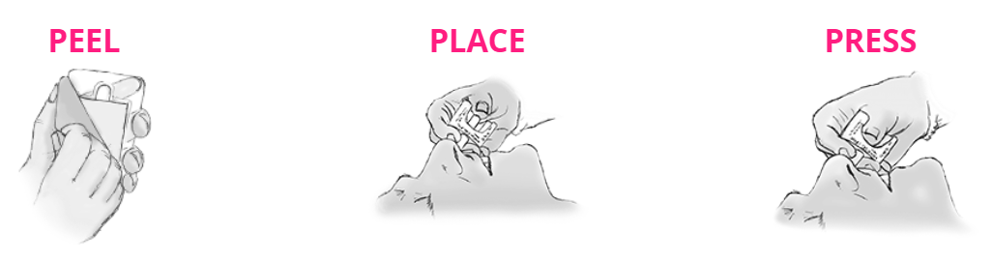
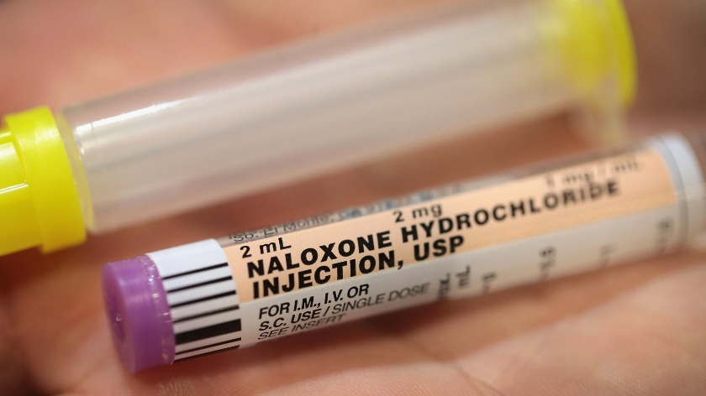
Reversing Drug: Naloxone
Intranasal
Intramuscular
Intravenous
Notes:
Better targeting of overdose reversing drugs helps save lives at the time of overdose. There are three different ways of administering overdose reversing drugs: intranasal spray, intramuscular injection, intravenous injection. Some local governments and communities even provide the public with free overdose reversing drug kits.

Slide 17

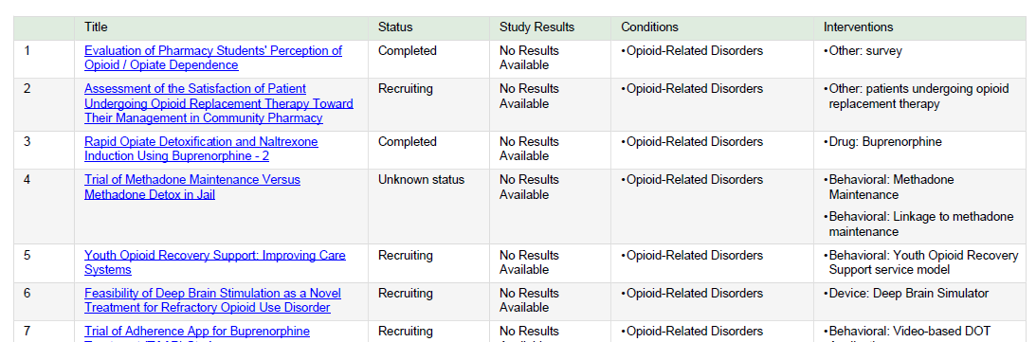
Clinical Studies
https://clinicaltrials.gov/
Status:
Recruiting, Enrolling by Invitation, Completed, Completed/Has Results, Terminated, etc.
Interventions:
Opioid Replacement Therapy, Survey, Buprenorphine Drug, Behavioral Methadone Maintenance, Youth Opioid Recovery Support Service Model, etc.
Notes:
Better research helps find effective treatments.
ClinicalTrials.gov is a database of privately and publicly funded clinical studies conducted around the world. You may find a study by status, condition or disease, intervention method, country, etc. The table shows search results of clinical trials for opioid-related disorder.
Reference: https://clinicaltrials.gov/

Slide 18
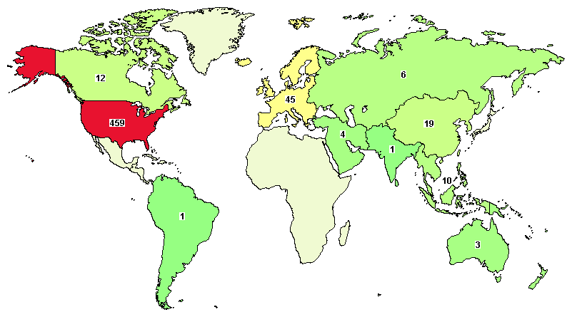
Clinical Studies
https://clinicaltrials.gov/
Notes:
Better research: In U.S. alone, there are 459 clinical studies for opioid-related disorders.
Reference: https://clinicaltrials.gov/ct2/results?cond=%22Opioid-Related+Disorders%22

Slide 19
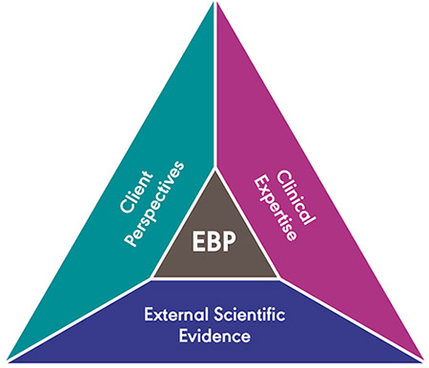
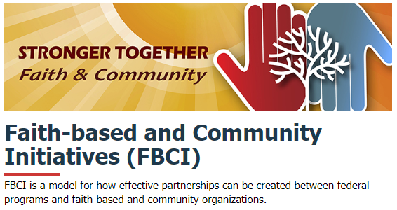
Effective Partnerships
Notes:
Nothing works better than effective partnerships among multi-sectors: faith-based organizations, communities, evidence-based researches that put together client perspectives, clinical expertise and external scientific evidence.

Slide 20
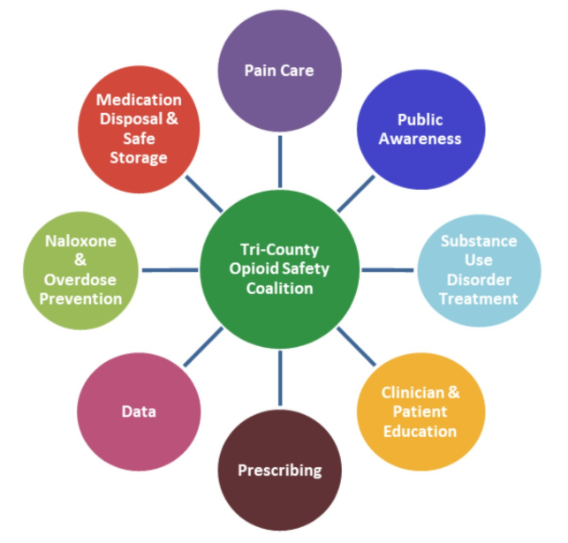
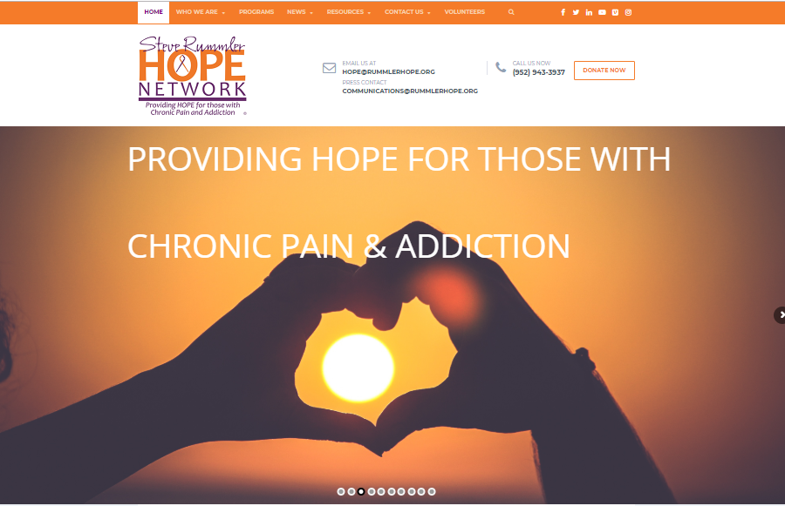
Oregon Tri-County Opioid Safety Coalition Steve Rummler HOPE Network
https://steverummlerhopenetwork.org/
Notes:
Partnerships among three county governments in Oregon. And a hope network created by mother of Steve Rummler who died of drug overdose to “Raise Awareness, Educate Prescribers, Prevent Overdose”.

Slide 21
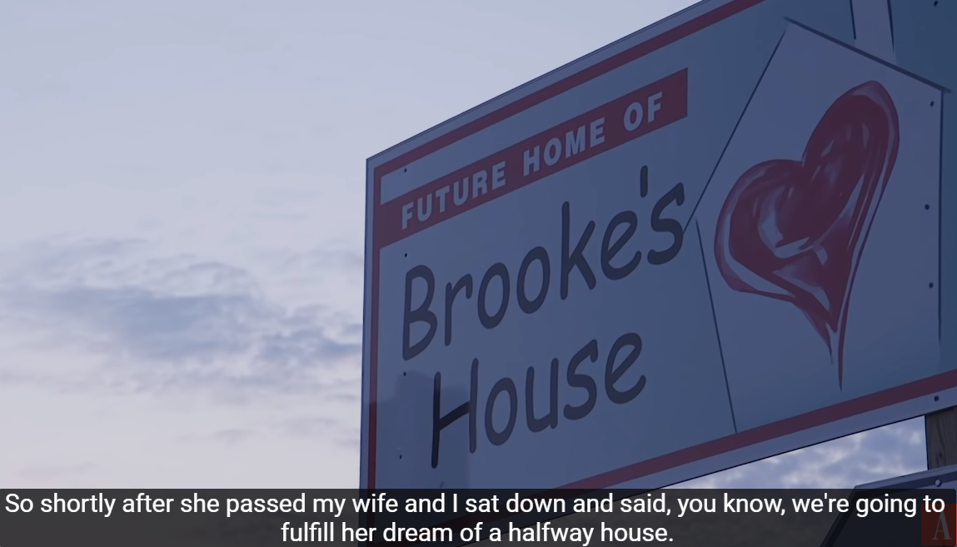
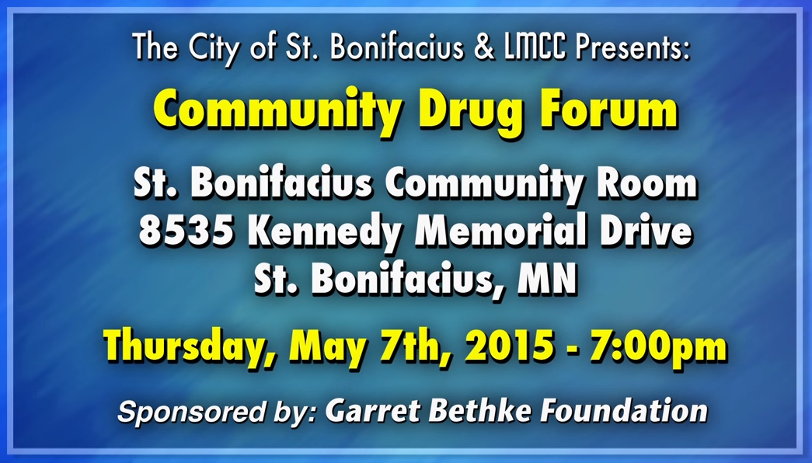
Other Initiatives from Victim’s Families

Slide 22
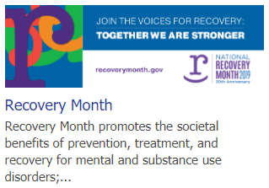
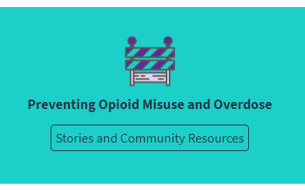
Awareness: Voices & Stories for Recovery
Notes:
Nothing makes America stronger and brings more awareness than the voices of people and families who are fighting the battle together. Together, America is stronger to fight this battle of one!

Slide 23
Questions & Discussion
Sau Kha
saukha@gmail.com
Notes:
DSSA-5301-Communicating Data Stories, Summer 2019

